Slide 1
Drug induced liver injury and Cirrhosis
Jennifer White, PharmD
William Carey University 2025

Slide 2
Objectives
Identify medications that are known hepatotoxins.
Discuss the typical clinical presentation of a patient with cirrhosis, including expected laboratory abnormalities as well as Child-Pugh scoring.
Use the Child-Pugh scoring system to accurately and safely dose medications for patients with cirrhotic liver disease.
Define portal hypertension and the role that portal hypertension plays in the formation of varices and variceal bleeding.
Discuss therapy for the primary and secondary prophylaxis against variceal bleeding.
Define ascites while relating it to spontaneous bacterial peritonitis.
Devise a full treatment plan for a patient with ascites.
Recommend an appropriate antibiotic regimen for a patient with spontaneous bacterial peritonitis.
Define hepatic encephalopathy, describing its precipitating factors and multiple clinical manifestations.
Construct an appropriate treatment recommendation for a patient with hepatic encephalopathy.
Describe side effects or adverse events associated with medication therapies for complication of cirrhosis.

Slide 3
Liver Function
Bile production
Fat-soluble vitamin storage and/or metabolism
Vitamins A, D, E, K
Drug metabolism
Bilirubin metabolism
Produces most proteins needed by the body and substances that regulate blood clotting
Metabolizes nutrients from food to produce energy when needed
Proteins (albumin), clotting factors, thrombopoietin (TPO)

Slide 4
Liver Function Tests (LFTs)
Lab | Normal Range | Trend with disease/injury
Aspartate Aminotransferase (AST) | 10-40 units/L | Increase (typically > 3 times the ULN)
Alanine Aminotransferase (ALT) | 10-40 units/L | Increase (typically > 3 times the ULN)
Alkaline Phosphatase (Alk Phos) | 33-131 IU/L | Increase
Total Bilirubin (Tbili) | 0.1-1.2 mg/dL | Increase
Albumin | 3.5-5 g/dL | Increase

Slide 5
Other labs
Lab | Normal Range | Trend with Disease/Injury
Ammonia | 19-60 mcg/dL | Increase
International normalized ratio (INR) | < 1.2 | Increase
Prothrombin time (PT) | 10-13 seconds | Increase
Activated partial thromboplastin time (aPTT or PTT) | 22-28 seconds | Increase
Platelets | 150,000 – 450,000 cells/mm³ | Decrease

Slide 6
Acute vs chronic labs
Acute Liver Toxicity
Chronic Liver Toxicity
Increase in AST/ALT
Increase in AST/ALT, however, in more advanced disease can be normal
Increased Alk Phos
Increased Tbili
Increased PT/INR
Decreased Albumin

Slide 7
Causes of Acute Liver Disease
Viral infections
Hepatitis A, B, C, D, and E
Alcohol consumption
Hepatotoxic drugs (Drug induced liver injury – DILI)
Blunt or penetrating trauma
Liver Shock(MI, cardiac arrest, septic shock)

Slide 8

Clinical Presentation of Liver Damage
Nausea/vomiting
Diarrhea
Jaundice
Lighter colored stool
Loss of appetite
Malaise
SOB
Confusion
Pain – upper right quadrant abdomen
Darkened urine
Edema/ascites

Slide 9
Drug-induced liver injury (DILI)

Slide 10
Drug-induced liver injury (DILI)
Most frequently caused by alcohol, antibiotics, antiseizure medications, and APAP
Also, herbal supplements
DILI accounts for 20% of acute liver failure in pediatrics patients and in adults
In ~75% of these cases, liver transplantation is required for survival
DILI is one of most frequent causes for withdrawal of meds from marketplace
Difficult to detect prior to drug approval

Slide 11
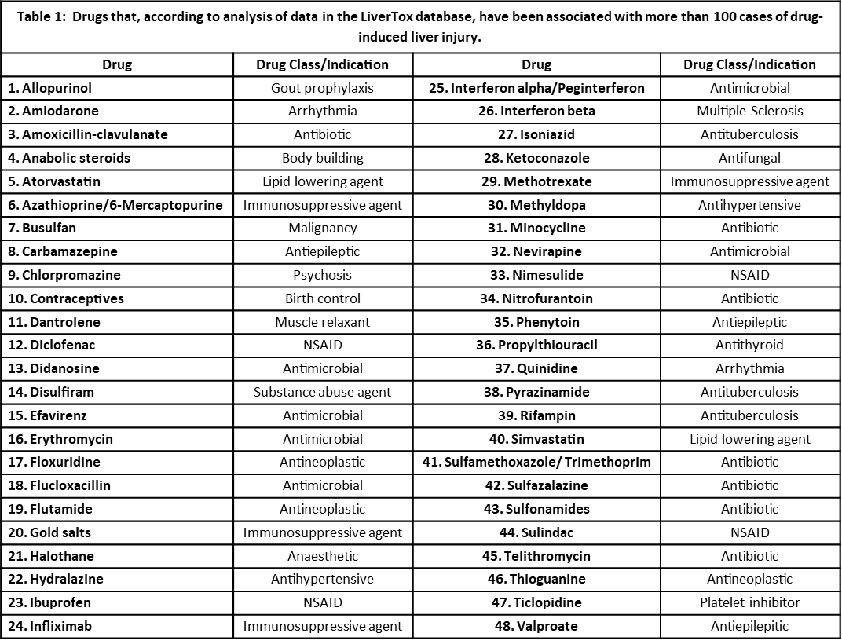
Hepatotoxic Medications Activity: What are the Top categories of medication listed in Table 1?

Slide 12
Key Elements for Attributing Liver Injury to a Drug
Drug exposure preceded the onset of liver injury
Especially if the drug is known for causing liver injury
Other causes of liver disease are excluded
Drug discontinuation leads to an improvement in liver injury
Rapid and severe recurrence occurs if there is repeated exposure to the drug
NOT advised to do a rechallenge
Treatment:
Stop the drug, especially of AST/ALT >3 times ULN

Slide 13
Key Drugs with Boxed Warning for Liver Damage
Acetaminophen (Tylenol)
Amiodarone (Cordarone)
Isoniazid (Nydrazid)
Ketoconazole (Nizoral)
Methotrexate (Trexall)
Nefazodone (Serzone)
Nevirapine (Viramune)
Propylthiouracil (PTU, Propycil)
Valproic Acid (Depakote)
Zidovudine (Retrovir)

Slide 14
Goals of treatment
Reducing the immediate damage of acute hepatitis and preserving the patient’s life
01
Decreasing the risk of cirrhosis
02

Slide 15
Risk factors for DILI
Older age
Females develop more severe hepatotoxicity. In males, occurs more often with azathioprine, anabolic steroids, and amox-clav
Race – Bactrim common cause in Black patients. Augmentin common in white patients. Asian patients more likely to need liver transplant or die from DILI.
Need to consider genetic polymorphisms – poor, intermediate, normal, rapid, or ultra-rapid metabolizer
DDI
Livertox:
https://www.ncbi.nlm.nih.gov/books/NBK547852/

Slide 16
Clinical presentation of Liver damage
Hepatocellular injury (hepatitis):
Disproportionate elevation in the serum aminotransferases compared with the alkaline phosphatase
Serum bilirubin may be elevated
Other tests like PT/INR be abnormal
Cholestatic injury (cholestasis):
Disproportionate elevation in the alkaline phosphatase compared with the serum aminotransferases
Serum bilirubin may be elevated, at times to very high levels
Other tests like PT/INR be abnormal

Slide 17
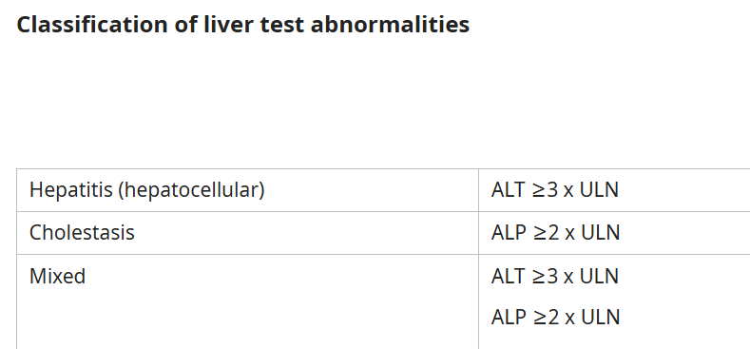

Slide 18
DILI Diagnosis
Patients with clinically significant DILI have at least one of the following:
AST or ALT > 5 times upper limit of normal (ULN) or ALP > 2 times ULN on two separate occasions
Total serum bilirubin >2.5 mg/dL with elevated AST, ALT, or ALP
INR > 1.5 with elevated AST, ALT, or ALP

Slide 19
Prognosis
Most patients will make full recovery
Poor prognosis:
The development of jaundice (defined as a bilirubin >2 times the upper limit of normal) in the setting of ALT >3 times the upper limit of normal
Acute liver failure due to antiepileptics in children
Acute liver failure due to APAP requiring hemodialysis
An elevated serum creatinine
Presence of pre-existing liver disease
Cholestatic DILI is more likely to develop into chronic injury

Slide 20
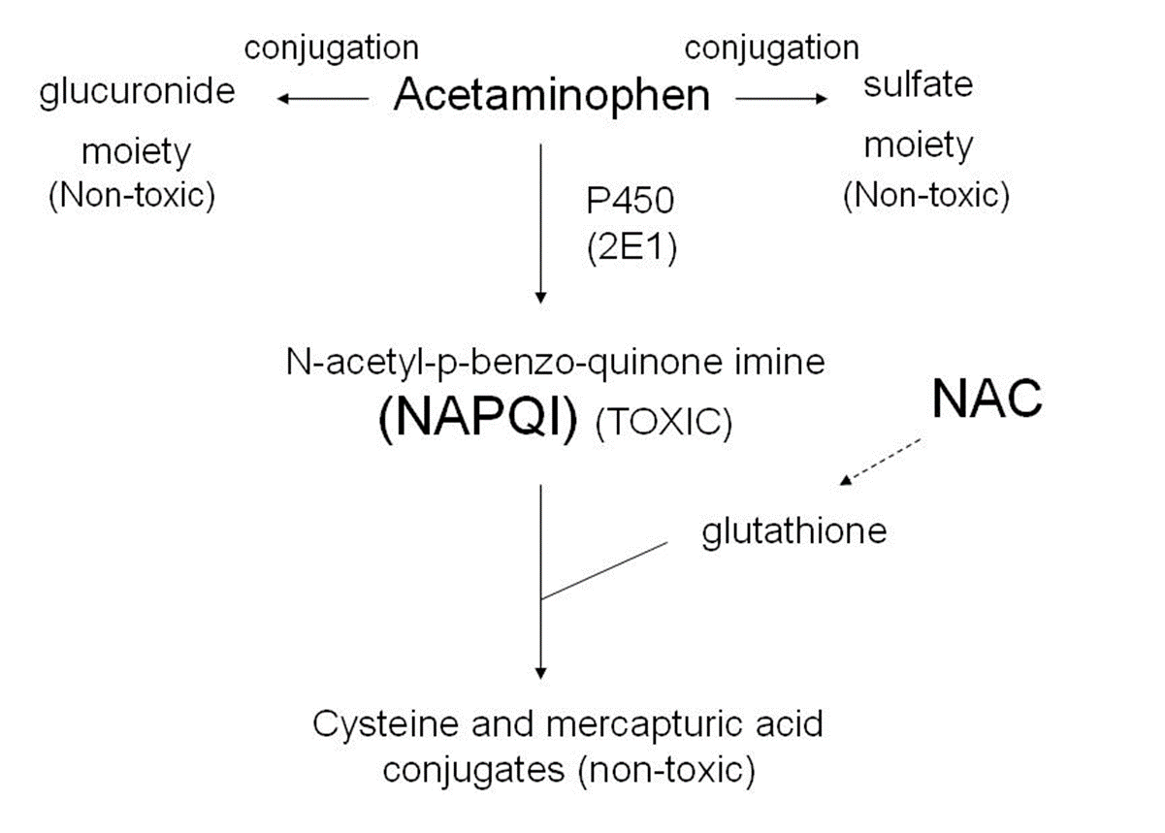
APAP toxicity
S/S: nausea, vomiting, breathing problems, abdominal pain

Slide 21
Video
https://youtu.be/4_idubwsRy8?si=Un73ehBsr1psBg-U

Slide 22
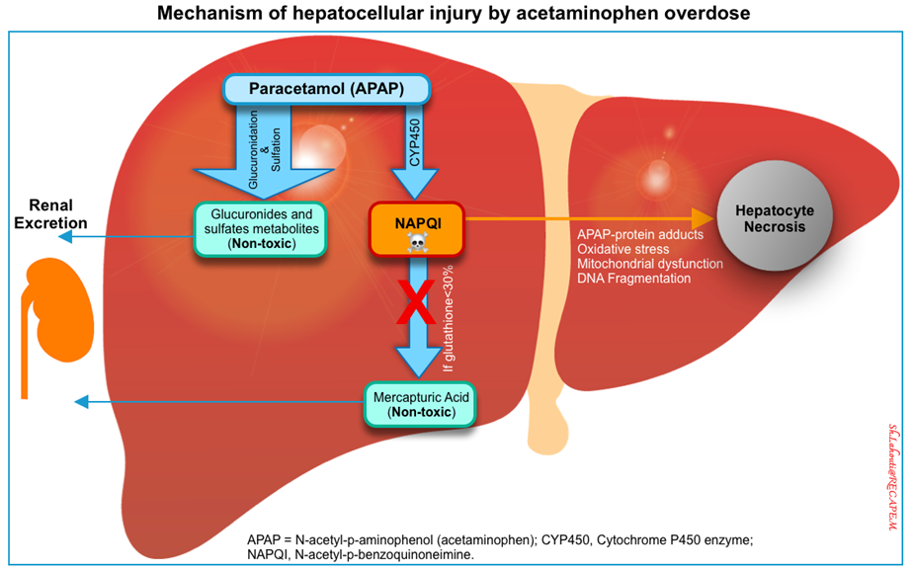
APAP toxicity treatment
N-acetylcysteine (NAC)
Almost 100% effective if given within 8 hours post-ingestion
MOA: repletes glutathione reserves by providing cysteine, an essential precursor to glutathione production
Binds to toxic metabolites and scavenges free radicals
IV or oral treatment options available
**Oral option is known for having terrible taste (think rotten eggs)
Lahouti, S., Shahriar Lahouti Founder, Founder, & posts, V. all. (2024, September 9). Acetaminophen (paracetamol) poisoning. RECAPEM. https://recapem.com/acetaminophen-paracetamol-poisoning/

Slide 23
NAC Stopping Criteria
NAC Stopping Criteria
Serum APAP concentration < 10 mcg/mL
INR < 2
Serum transaminases are normal for the patient or, if elevated, have decreased from the peak by 25% - 50%
Patient is clinically well
Interpret serum APAP concentrations in relation to time since ingestion, to assess potential hepatotoxicity

Slide 24
Alcohol-Associated Liver Disease (ALD)
Acute Toxicity Chronic Hepatitis

Slide 25
Alcoholic Liver Disease
Chronic alcohol ingestion over a long period of time causes “steatosis” (fatty liver) due to fat deposition in the hepatocytes
Can be reversible and self-limiting (if drinking is stopped) or progress to alcoholic hepatitis, fatty liver (steatohepatitis), or chronic hepatitis with hepatic fibrosis or cirrhosis

Slide 26
ALD Treatment
Alcohol cessation
Non-pharmacological: alcohol rehabilitation programs, support group
Pharmacological: control alcohol withdrawal symptoms
Mild withdrawal:
Gabapentin (Neurontin)
Carbamazepine (Tegretol)
Prevent relapses:
Naltrexone (Vivitrol)
Acamprosate (Campral)
Disulfiram (Antabuse)
Thiamine (vitamin B1) is used to prevent and treat Wernicke’s encephalopathy

Slide 27
Cirrhosis Chronic Liver Disease

Slide 28
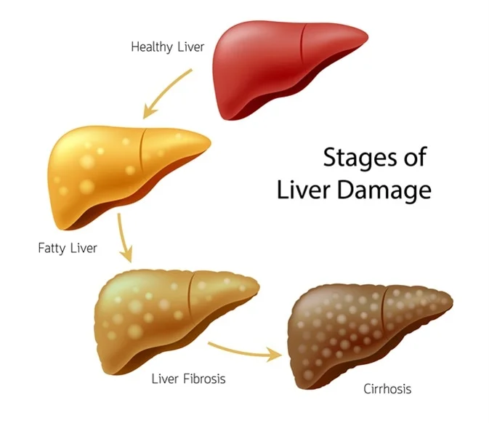
Cirrhosis
Caused by chronic liver injury
Normal tissue develops regenerative nodules surrounded by dense fibrotic material
Impacts portal blood flow, hepatocyte perfusion, and hepatic synthetic functions
Can lead to portal hypertension, varices, and variceal bleeding, ascites, infection, encephalopathy, and hepatocellular carcinoma

Slide 29
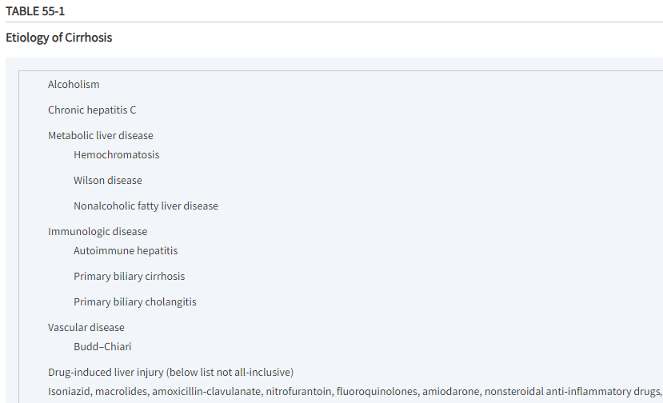


Slide 30
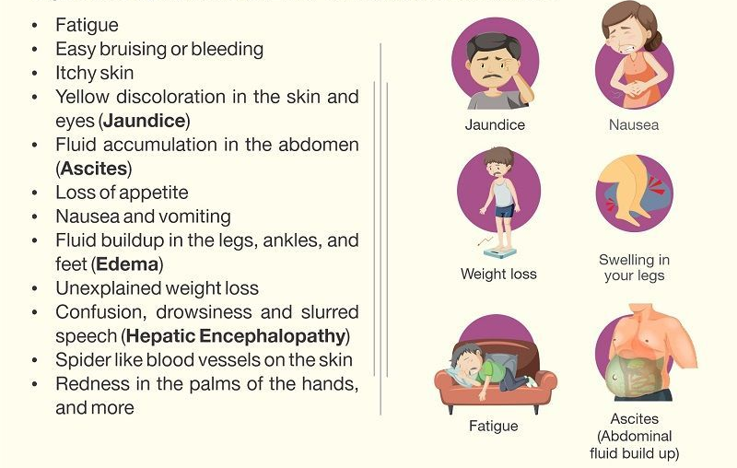
Presentation

Slide 31
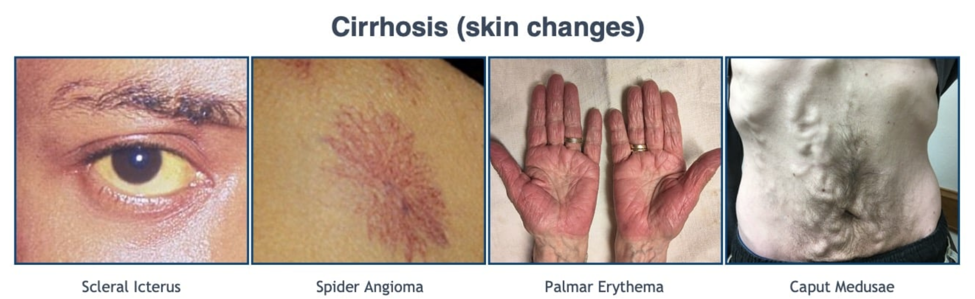
Clinical Presentation

Slide 32
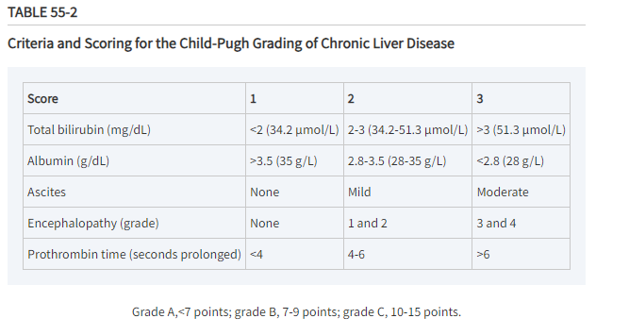
Child-Pugh Classification

Slide 33
A patient has the following information: albumin 4.1 g/dL (41 g/L), serum bilirubin 3.3 mg/dL (56.4 µmol/L), prothrombin time that is 5 seconds prolonged, no ascites, and no encephalopathy. In terms of Child-Pugh score, what is the patient’s severity?
Grade A
Grade B
Grade C
Grade D

Slide 34
General approach to treatment
Identify and eliminate causes of cirrhosis if possible
Drinking cessation, avoidance of hepatoxic drugs/supplements
Assess for complications
Risk for variceal bleeding Initiate prophylaxis when indicated
Signs of ascites pharmacologic therapy and paracentesis; monitor for SBP- spontaneous bacterial peritonitis
Monitor for hepatic encephalopathy (HE) treat with dietary restrictions, eliminate precipitating factors, and initiate therapy to lower ammonia levels
Monitor for signs of hepatorenal syndrome, pulmonary insufficiency, and endocrine dysfunction

Slide 35
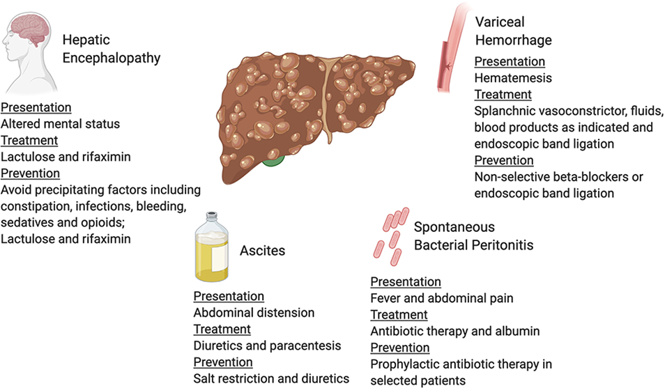
Complications of Cirrhosis

Slide 36
Portal Hypertension
Occurs when there is resistance to portal blood flow = increased resistance and structural changes due to the buildup of scar tissue
Usually asymptomatic until complications develop
Ascites, variceal hemorrhage, SBP, etc
Diagnosis: If patient has known risk factors and clinical manifestation, then additional testing is not needed. If in doubt, can use hepatic venous pressure gradient (HVPG)
Notes:
The HVPG is measured to approximate the gradient in pressure between the portal vein and the inferior vena cava.

Slide 37
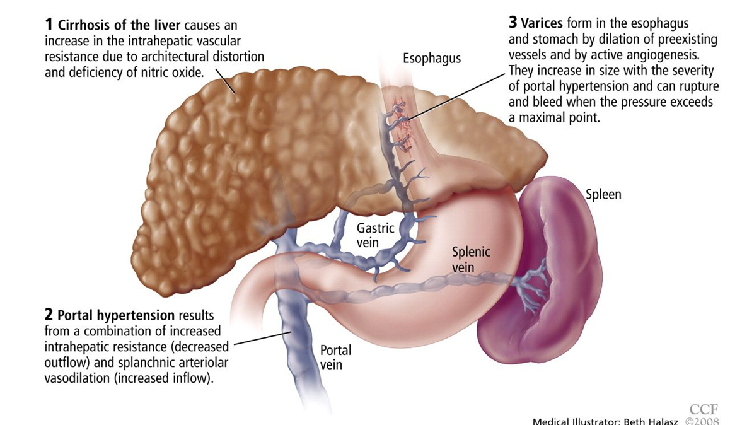
How Liver Disease Leads to Bleeding Varices

Slide 38
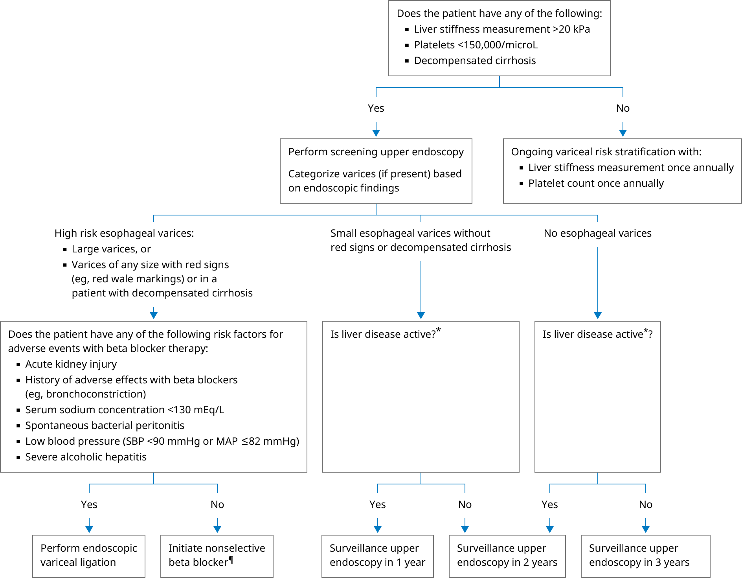
Screening for Varices

Slide 39
Variceal Bleeding
Three strategies
Primary prophylaxis (prevention of first episode)
Treatment of acute variceal hemorrhage
Secondary prophylaxis (prevention of rebleeding)

Slide 40
Primary Prophylaxis
Nonselective Beta Blockers: propranolol, nadolol, carvedilol
MOA: Reduce portal pressure by decreasing cardiac output by blocking beta-1 receptors and decrease in splanchnic blood by blocking beta-2 receptors
Given to patients with varices present, not given to prevent the formation of varices
Preferred agents: propranolol 20-40 mg PO BID or nadolol 20-40 mg daily
Titrate dose to resting HR of 55-60 beats/min, SBP > 90 mmHg

Slide 41
Acute Variceal Hemorrhage
Medical emergency – mortality rate 7-15%, admission to ICU
Course of action:
Adequate fluid resuscitation
Protection of airway from aspirating blood
Control bleeding
Prevention re-bleeding
Prevent AKI
Preserve liver function
Prophylaxis against SBP/other infections

Slide 42
Acute Variceal Hemorrhage
Stop/slow bleeding
Administer octreotide IV bolus 50 mcg followed by continuous IV infusion of 50 mcg/hr (up to 2-5 days)
MOA: Vasoconstricts the splanchnic (GI) circulation to stop/minimize bleeding
ADRs: bradycardia, HTN, arrhythmia, and abdominal pain
Alternative: Vasopressin
Abx to prevent spontaneous bacterial peritonitis (SBP) – IV ceftriaxone 1g/day for up to 7 days

Slide 43
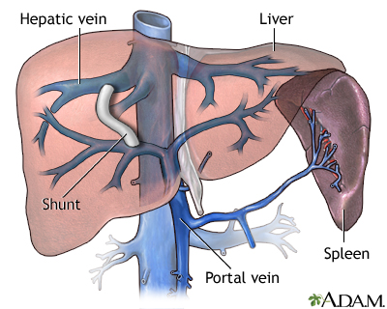
Secondary Prophylaxis
Rebleeding occurs in ~ 60% of patients and has mortality rate of 33%
TIPS procedure (Transjugular intrahepatic portosystemic shunt)
Tx with nadolol or propranolol only, not carvedilol plus EVL (endoscopic variceal ligation)
Notes:
Transjugular intrahepatic portosystemic shunt (TIPS) is a procedure that involves inserting a stent (tube) to connect the portal veins to adjacent blood vessels that have lower pressure. This relieves the pressure of blood flowing through the diseased liver and can help stop bleeding and fluid back up.

Slide 44
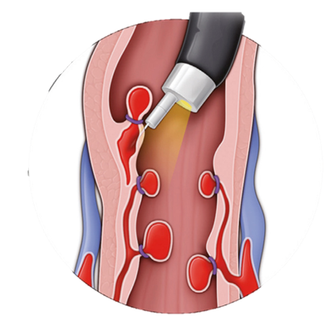
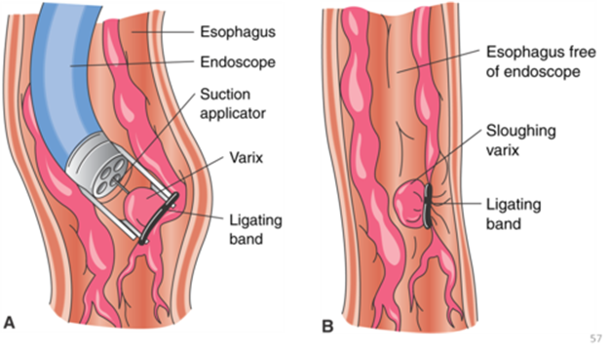
Other Procedures for Bleeding
Band Ligation
Sclerotherapy
Notes:
Sclerotherapy is an endoscopic procedure to treat active esophageal variceal bleeding by injecting a sclerosant agent into or near the varix to induce thrombosis and obliteration
The EVL technique is similar to hemorrhoidal banding; it works by capturing the varix within a small band, resulting in occlusion from thrombosis. The tissue then becomes necrotic and sloughs off in a few days to weeks, leaving a superficial mucosal ulceration that will heal completely. EVL avoids the use of sclerosant solution and thus eliminates the risk of transmural injury to the esophageal wall that often occurs after endoscopic sclerotherapy.

Slide 45
Which of the following represents an appropriate goal for a patient started on propranolol for variceal bleeding prophylaxis?
Heart rate of 55 to 60 beats/min; diastolic blood pressure > 90 mm Hg
Heart rate of 55 to 60 beats/min; systolic blood pressure > 90 mm Hg
Heart rate of 60 to 65 beats/min; diastolic blood pressure > 90 mm Hg
Heart rate of 60 to 65 beats/min; systolic blood pressure > 90 mm Hg

Slide 46
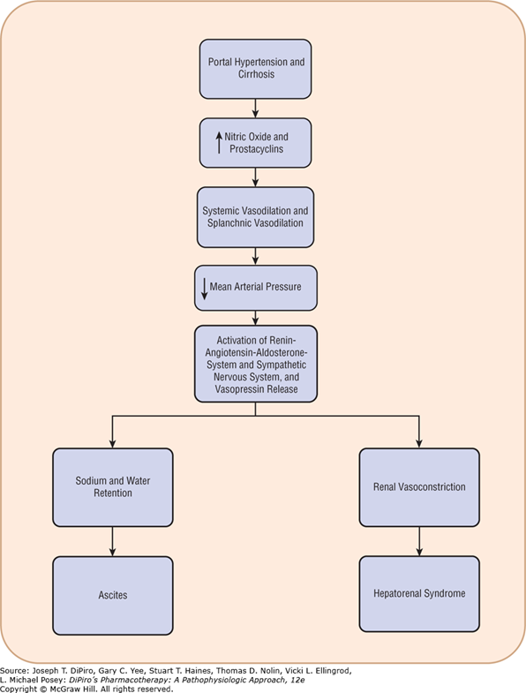
Pathogenesis of Ascites

Slide 47
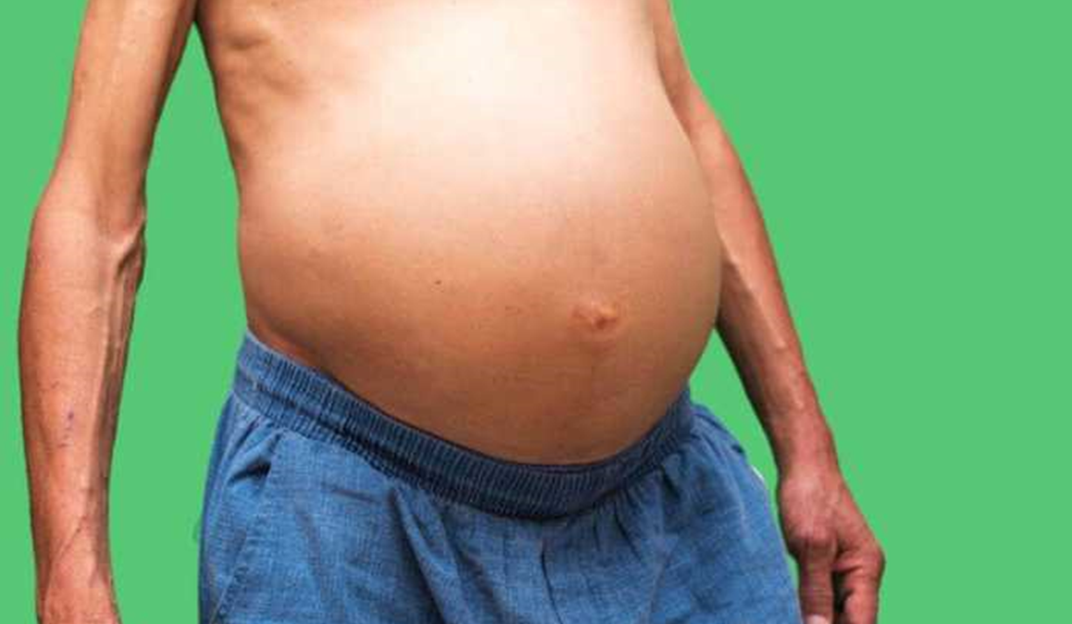
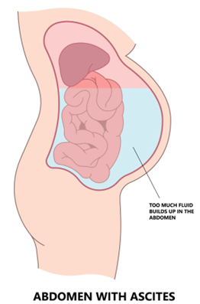
Ascites
Accumulation of an excessive amount of fluid within the abdomen
Most common major complication of cirrhosis

Slide 48
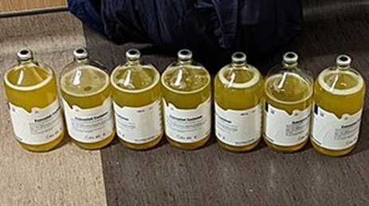
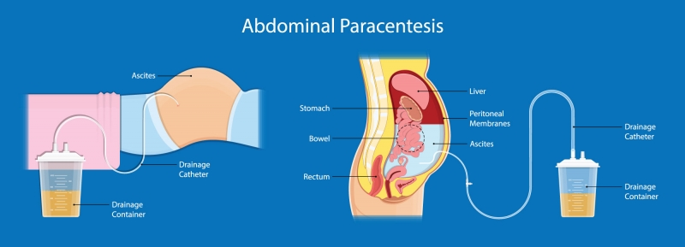
Ascites Treatment
Paracentesis for new-onset ascites
Sodium restriction of 2000 mg/day
Aldosterone antagonist or aldosterone antagonist + loop diuretic
Spironolactone 100 mg PO QD+ furosemide 40 mg PO QD
Abstain from alcohol

Slide 49
Spontaneous Bacterial Peritonitis
Infection of ascitic fluid that occurs in the absence of any evidence of an intraabdominal, surgically treatable source of infection
Thought to be related to altered intestinal permeability and resultant bacterial translocation
Common causes: E.coli, Klebsiella pneumonia, pneumococci
Symptoms: abdominal pain, diarrhea, vomiting
Diagnosis: Positive ascitic fluid bacterial culture and elevated ascitic fluid cell count for leukocytes
Treatment
Broad spectrum antibiotics – 3rd gen cephalosporin (cefotaxime or ceftriaxone (Rocephin))
If concern for multi-drug resistant organism (MDRO)- piperacillin/tazobactam (Zosyn)
Add vancomycin if concern for methicillin resistant S. aureus (MRSA)

Slide 50
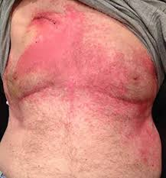
SBP Antibiotics Adverse Effects
3rd generation cephalosporins: cefotaxime or ceftriaxone (Rocephin)
Strong association with risk of C. difficile infections, N/V/D
Extended-Spectrum Penicillins + Beta-Lactamase Inhibitors: Piperacillin/tazobactam (Zosyn)
Drug-induced thrombocytopenia, nephrotoxicity, neurotoxicity
Vancomycin
Red-Man Syndrome, drug-induced fever, nephrotoxicity

Slide 51
Which of the following symptoms is most consistent with Spontaneous Bacterial Peritonitis?
A. Increased serum bilirubin and jaundice
B. Increased leukocytes in ascites fluid
C. Increased serum ammonia
D. Decreased serum albumin levels
E. Increased INR and bleeding

Slide 52
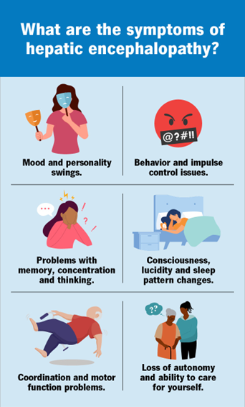
Hepatic Encephalopathy
Functional disturbance of the brain caused by liver insufficiency
Accumulation of neurotoxic substances occur and enter into the CNS
Ammonia is most common culprit, but can also be glutamine, benzodiazepine receptor agonists, and aromatic amino acids
Commonly see increased levels of ammonia in acute and chronic liver disease
Symptoms: confusion, personality changes, disorientation, depressed level of consciousness, lethargy
Can eventually lead to coma and death

Slide 53
Hepatic encephalopathy treatment
Non-Pharmacologic:
Protein Restriction: 1 to 1.5g/kg/day
High fiber diet (favor plant-based proteins- beans, etc)
Non-absorbable disaccharide
Lactulose: 20 to 30 g (30 to 45 mL) every 1 to 2 hours to induce ~2 soft stools/day, then reduce to 20 to 30 g (30 to 45 mL) 2 to 4 times daily; may adjust dose every 1 to 2 days to achieve 2 to 3 soft stools/day
Can also be given as rectal enema
Can also consider PEG 3350
Antibiotics:
Neomycin, Metronidazole
High risk of neurotoxicity, lower effectiveness
Rifaximin (Great drug, $$$)
Low systemic absorption

Slide 54
Your patient has a history of chronic alcohol use and cirrhosis and now presents with altered mental status with alternating delirium and loss of consciousness. He has no evidence of ascites or hematemesis. Which of the following is your immediate next step?
A. Assessing the patient for GI bleeding with a stool blood test.
B. Administering systemic antibiotics for bacterial peritonitis.
C. Assessing ammonia levels and screening for hepatic encephalopathy.
D. Sending a sample of blood to check blood alcohol levels.

Slide 55
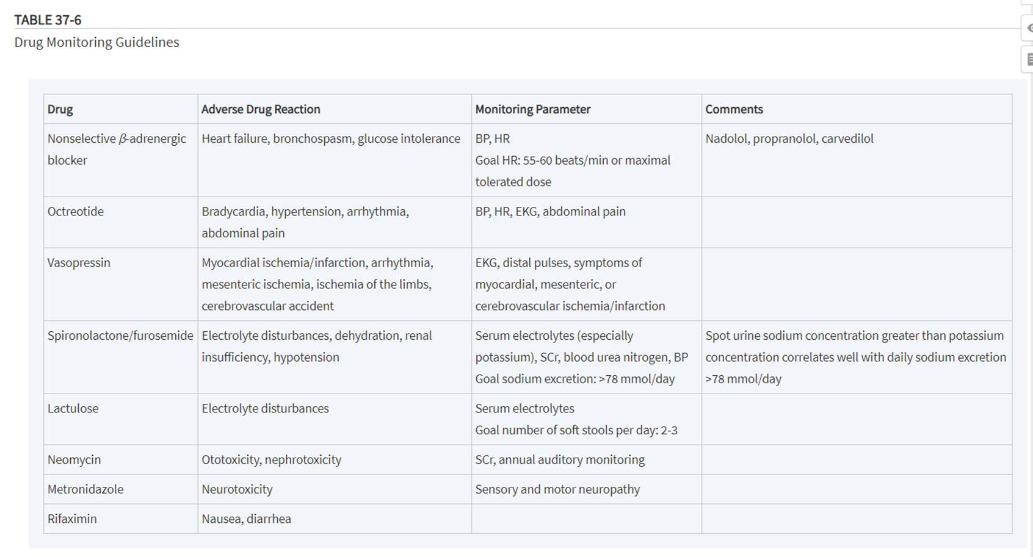

Slide 56
Special Considerations: PK/PD changes
These patients have reduced liver blood flow, loss of CYP enzyme activity, decreased first pass extraction, hypoalbuminemia, ascites, impaired biliary excretion, etc
May also increased sensitivity to certain medications such as NSAIDS, benzos, opiates. Be aware of prodrugs (codeine, clopidogrel)
Requires closer monitoring for therapy response and anticipating drug accumulation
Prefer drugs without hepatic metabolism or those that do not have active metabolites
Ex: Lorazepam is metabolized via conjugation but no active metabolites. Diazepam is oxidized in the liver and has active metabolites. Easier to monitor the lorazepam.

Slide 57

Questions?

